Slide 1

Seminar ON Management Of Shock In Children
Modulator: Dr. Betre (MD and assistant professor of Pedi. & Child health)
Presenters:- Galane Haile
. Kalkidan Araya
. Maryama Idris
. Nasifay Abebe

Slide 2
Outline
Objectives
Introduction & Definition
Pathophysiology
Stages of Shock
Classification of Shock
Clinical Presentations
Principles of Management
Specific Management by Type
Prognosis & Summary

Slide 3
Objective
At the end of this seminar the participants will be able to;
Define shock and describe its pathophysiology
Identify the stages and classifications of pediatric shock
Recognize clinical presentations and diagnostic indicators
Outline evidence-based management strategies
Describe complications and prognosis of shock

Slide 4
Definition & Significance
Definition: An acute, life-threatening state of cardiovascular insufficiency characterized by inadequate delivery of oxygen and nutrients to meet the metabolic demands of vital organs, resulting in cellular dysfunction and injury.
Shock results from energy failure due to inadequate oxygen and glucose delivery to meet metabolic demands. It is a leading cause of death and disability in children worldwide.

Slide 5
Epidemiology
Shock occurs in approximately 2% of all hospitalized infants, children, and adults in the USA, and the mortality rate varies according to the clinical circumstances.
Many die because of complications and Multiple Organ Dysfunction Syndrome (MODS) .
Early recognition and treatment significantly improve outcomes.

Slide 6

Tissue hypoxia
Anaerobic metabolism
Inadequate tissue perfusion
Anaerobic metabolism
Accumulation of lactic acid & CO₂
Irreversible cell and organ damage

Slide 7
Stages of Shock
Shock progresses along a continuum of severity :
Compensated Shock:
Compensatory mechanisms maintain adequate blood pressure
Tachycardia and increased systemic vascular resistance occur
Blood pressure remains normal despite inadequate tissue perfusion
A child can lose 30-35% of circulating blood volume and still maintain normal blood pressure

Slide 8
Stages of Shock
Decompensated (Hypotensive) Shock:
Compensatory mechanisms fail
Hypotension develops (blood pressure drops below age-specific thresholds)
End-organ perfusion is severely compromised
Irreversible Shock:
Progressive end-organ dysfunction and failure occur
Cellular death follows
The patient is unresponsive to resuscitative efforts
Critical Takeaway: Hypotension is a late finding in pediatric shock, making early recognition crucial .

Slide 9
Classification of Shock
Hypovolemic shock
Cardiogenic shock
Distributive shock: septic shock, Anaphylactic shock, Neurogenic shock
Obstructive shock: Cardiac tamponade, Tension pneumothorax, Massive pulmonary embolism.

Slide 10
Classification of Shock
Shock is generally categorized into five major types :
Hypovolemic Shock:
This is the most common cause of shock in children worldwide. It is most frequently caused by acute fluid losses resulting from diarrhoea, vomiting, or haemorrhage.

Slide 11
Classification of Shock
Distributive Shock:
This type is characterized by inappropriate vasodilation, pooling of blood in the peripheral vasculature, and leakage of blood plasma through a compromised endothelial barrier. Common causes include:
sepsis
anaphylaxis
neurogenic shock and drug overdose.

Slide 12
Classification of Shock
Cardiogenic Shock:
This results from pump failure and decreased cardiac output. It is seen in patients with:
congenital heart disease
congenital or acquired cardiomyopathies
acute myocarditis, and multisystem inflammatory syndrome in children (MIS-C).

Slide 13
Classification of Shock
Obstructive Shock:
This occurs when a lesion creates a mechanical impediment to ventricular blood outflow. Causes include:
pericardial tamponade
tension pneumothorax,
pulmonary embolism and ductal-dependent left-sided heart lesions.

Slide 14
Classification of Shock
Dissociative Shock:
This is a special category in which cellular oxygen delivery or utilization is severely impaired despite sustained or supernormal tissue perfusion. Causes include severe anaemia, methemoglobinemia, carbon monoxide poisoning, and thiamine deficiency.
Note: Septic shock is often discussed in conjunction with distributive shock but involves a more complex interaction of distributive, hypovolemic, and cardiogenic components

Slide 15
Septic shock
fever (or hypothermia) along with evidence for either a systemic or localized infection
Infants and young children most commonly present with “cold shock
Older children and adolescents more commonly present with “warm shock
Notes:
Infants and young children most commonly present with “cold shock,” with features of hypovolemic and cardiogenic shock predominating, including tachycardia, delayed capillary refill, cool extremities, diminished peripheral pulses, and decreased pulse pressure.
Older children and adolescents, especially those with sepsis from indwelling central venous catheters, more commonly present with “warm shock” that resembles distributive shock, including tachycardia, flash capillary refill, warm extremities, bounding peripheral pulses, and increased pulse pressure.
However, the pathobiology of sepsis can evolve over time and with treatment in children, such that “warm shock” may shift to “cold shock” or vice vers
In addition to the traditional description of septic shock, a subgroup immunophenotype presents with hyperferritinemia.
Ferritin levels >3,000 mg/mL often predict a poor prognosis and the need for ICU admission.

Slide 16
Neurogenic shock
is a type of distributive shock
caused by a sudden disruption of sympathetic nerve stimulation to the vascular smooth muscle leading to a profound decrease in vasomotor tone,
Can results in bradycardia, or at least absence of the usual tachycardic response to hypotension.
Notes:
Unlike other types of shock, the unopposed vagal activity classically results in bradycardia, or at least absence of the usual tachycardic response to hypotension.

Slide 17
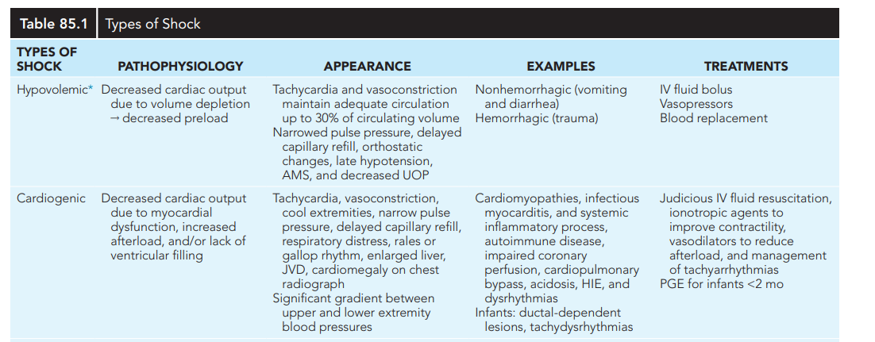

Slide 18
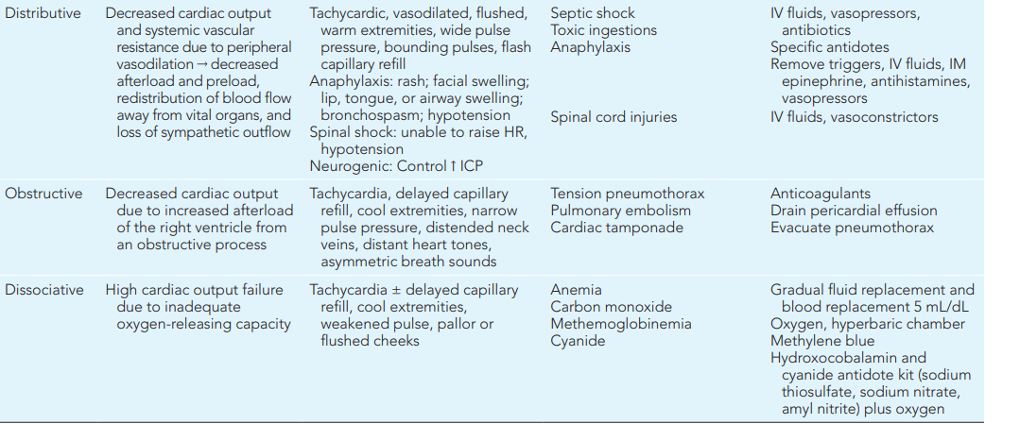

Slide 19
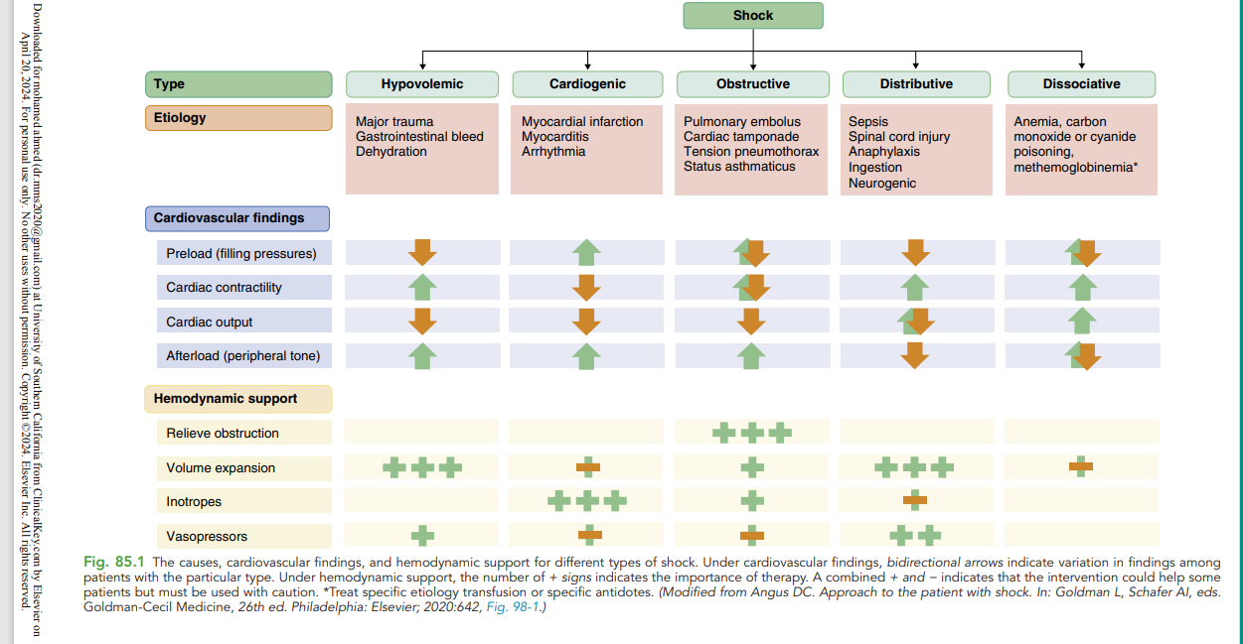

Slide 20
Classification Based on Treatment Response
Fluid-Responsive Shock:
The patient shows hemodynamic improvement after initial fluid bolus (10-20 mL/kg)
Heart rate decreases, perfusion improves
No further escalation of therapy required
Fluid-Refractory Shock:
Shock persists despite adequate fluid resuscitation
Defined as requiring ≥40-60 mL/kg of fluid without clinical improvement
Requires initiation of vasoactive medications
Notes:
Shock state can be present before the onset of hypotension
Hypotension is often a late finding, especially in infants and young children, and is not a criterion for the diagnosis of shock because of a complex set of compensatory mechanisms that attempt to preserve BP and peripheral perfusion.
Hypotension reflects an advanced state of uncompensated shock and is associated with increased morbidity and mortality

Slide 21
Classification Based on Treatment Response
Catecholamine-Resistant Shock:
Shock persists despite adequate doses of vasoactive agents
Requires evaluation for atypical etiologies
May need stress-dose corticosteroids or ECMO
Notes:
Shock state can be present before the onset of hypotension
Hypotension is often a late finding, especially in infants and young children, and is not a criterion for the diagnosis of shock because of a complex set of compensatory mechanisms that attempt to preserve BP and peripheral perfusion.
Hypotension reflects an advanced state of uncompensated shock and is associated with increased morbidity and mortality

Slide 22
Clinical Presentations
Signs and symptoms reflect impaired circulation and end-organ perfusion:
Vital Signs:
Tachycardia is the most common early sign
Tachypnea often occurs secondary to acidemia
Bradycardia is a late and ominous sign
Notes:
Shock state can be present before the onset of hypotension
Hypotension is often a late finding, especially in infants and young children, and is not a criterion for the diagnosis of shock because of a complex set of compensatory mechanisms that attempt to preserve BP and peripheral perfusion.
Hypotension reflects an advanced state of uncompensated shock and is associated with increased morbidity and mortality

Slide 23
Con’d
Perfusion:
Prolonged capillary refill time (>2 seconds)
Diminished peripheral and/or central pulses
Cool extremities and mottled skin
Flash capillary refill and bounding pulses in distributive shock

Slide 24
Con’d
Mental Status:
Irritability, confusion, lethargy, or restlessness
Altered consciousness is an early sign in children
Other Signs:
Oliguria (urine output <0.5-1 mL/kg/hour)
Dry mucous membranes and poor skin turgor
Ileus and cyanosis
Respiratory distress and diminished breath sounds
Jugular vein distention and muffled heart sounds

Slide 25
Con’d
Diagnostic Indicators:
Metabolic acidosis
Hyperlactatemia (lactate >2-4 mmol/L is concerning)
Low central venous oxygen saturation

Slide 26
General Principles of Management
Early Recognition:
This is the key to survival. The initial signs of shock may be subtle in children as their compensatory mechanisms are very effective.
ABCDE Approach:
A (Airway): Ensure airway patency and adequacy of breathing. Consider intubation if the patient cannot protect their airway or if respiratory failure is present.
B (Breathing): Provide supplemental oxygen if hypoxemia (SpO₂ <92-94%) is present. High-flow oxygen should be given to maintain SpO₂ above 95%.

Slide 27
General Principles of Management
C (Circulation): Establish vascular access immediately (two large-bore IVs or intraosseous access if IV access is not achieved within 2 attempts).
D (Disability): Assess neurological status and level of consciousness.
E (Exposure): Check for other injuries, rashes, or sources of infection, and maintain normothermia.

Slide 28
General Principles of Management
Laboratory Evaluation:
Blood culture (before antibiotics if possible)
Blood gas analysis (including lactate)
Blood glucose, electrolytes, calcium, magnesium
Full blood count, coagulation studies
Antibiotics:
In septic shock, broad-spectrum antibiotics should be given within 1 hour of recognition, ideally after blood cultures are obtained
Key Principle: Reassess the patient after every intervention to determine the response to therapy.

Slide 29
Fluid Resuscitation
Initial Bolus:
10-20 mL/kg isotonic crystalloid (Normal Saline or Ringer's Lactate) over 15-20 minutes
Balanced salt solution is preferred over Normal Saline as bolus fluid therapy
For cardiogenic shock: use 5-10 mL/kg boluses with careful monitoring
Subsequent Boluses:
Repeat 10-20 mL/kg, reassessing after each
Up to 40-60 mL/kg may be needed in the first hour
May exceed 200 mL/kg over several hours in severe cases.
Notes:
Fluid should be administered via IV push or a rapid infuser system

Slide 30
Fluid Resuscitation
Precautions:
Assess the response of prior bolus therapy before repeating
Ensure signs of fluid overload have not developed (hepatomegaly, crackles)
Cumulative fluid overload >10% is associated with increased mortality
Escalation:
For children with evidence of fluid overload, adequate intravascular volume, or lack of hemodynamic improvement with prior fluid boluses, resuscitation should shift from volume resuscitation to vasoactive medications.
Notes:
Fluid should be administered via IV push or a rapid infuser system

Slide 31
Principles of Management - Vasoactive Medications
Indications:
Vasoactive medications should be initiated for children with fluid-refractory shock.
Choice of Agent Based on Shock Type:
Epinephrine:
This is the preferred first-line vasoactive therapy for fluid-refractory septic shock and cardiogenic shock. Epinephrine is preferred over dopamine as a first-line vasoactive in paediatric septic shock.
Norepinephrine:
This is recommended as first-line vasoactive therapy for children with distributive shock or neurogenic shock (warm shock with low SVR).
Notes:
Fluid should be administered via IV push or a rapid infuser system

Slide 32
Principles of Management - Airway and Breathing
Oxygen Therapy:
Supplemental oxygen if SpO₂ is 92-94%
Universal administration of high FiO₂ in severe anemia or dissociative shock
All children with shock should receive high-flow oxygen to maintain SpO₂ above 95%
Indications for Intubation and Mechanical Ventilation:
Type 1 respiratory failure (hypoxemic)
Persistence of circulatory failure despite resuscitation
Inability to protect the airway
Notes:
Fluid should be administered via IV push or a rapid infuser system

Slide 33
Principles of Management - Airway and Breathing
Depressed level of consciousness
Impending respiratory failure
Important Consideration:
Ensure fluid resuscitation is commenced prior to intubation, as anaesthetic agents and mechanical ventilation may cause hypotension in a shocked patient.
Sedation:
Avoid etomidate for sedation during intubation in septic shock patients.
Notes:
Fluid should be administered via IV push or a rapid infuser system

Slide 34
Principles of Management - Correcting Metabolic Abnormalities
Hypoglycemia:
Always check blood glucose in any child with shock
Hypoglycemia is common in shock patients
If hypoglycemia is present (BGL <3.0 mmol/L or symptomatic), administer 2 mL/kg of 10% Glucose as a bolus
Ensure maintenance fluids contain 5-10% Glucose
Notes:
Fluid should be administered via IV push or a rapid infuser system

Slide 35
Principles of Management - Correcting Metabolic Abnormalities
Hypocalcemia:
Calcium should be corrected during initial resuscitation
Optimize serum calcium levels to support cardiac function
Electrolyte Abnormalities:
Correct potassium and magnesium deficiencies
These may optimize cardiac function
Acid-Base Disturbances:
Metabolic acidosis is common and should be monitored
Improving perfusion is the primary treatment for acidosis
Notes:
Fluid should be administered via IV push or a rapid infuser system

Slide 36
Hemodynamic targets
Includes;-
Decrease in HR;
Increase in BP;
Normalization of capillary refill
4.Peripheral pulse strength, and

Slide 37
Con’d
5.Extremity temperature;
6.Improved urine output and
7.Fall in blood lactate by ≥10–20%.
Before repeating a fluid bolus, assess the response of prior bolus theraphy
And ensure that signs of fluid overload have not developed.

Slide 38
Con’d
For children with
evidence of fluid overload,
adequate intravascular volume,
lack of hemodynamic improvement with prior fluid boluses, resuscitation should shift from volume resuscitation to vasoactive medications

Slide 39
Con’d
The optimal fluid type for initial shock resuscitation could be
1.Crystalloids
0.9% normal saline
RL
Hartmann solution, and Plasma-Lyte
2.Colloids

Slide 40
Other treatments
Resuscitation with blood products should be prioritized for children with hemorrhagic shock.
Vasoactive medications should be initiated for children with fluid refractory shock,
epinephrine is the preferred first-line vasoactive therapy for fluid-refractory septic shock

Slide 41
Con’d
Epineprine is also the recommended initial vasoactive agent in children with cardiogenic shock.
However, in children with a low-SVR state, distributive, septic, or neurogenic shock, norepinephrine as the first-line vasoactive therapy.
hypoglycemia and hypocalcemia should be corrected during the initial resuscitation
Notes:
NE and Epi dose range 0.05-2microgram/kg/min
such as hypoglycemia and hypocalcemia, may precipitate or worsen shock

Slide 42
Specific Management
Cardiogenic shock
Early treatment with inotropes such as epinephrine, dopamine, dobutamine, or milrinone
Cautious fluid administration (5-10 mL/kg over 20-30 minutes if needed)
Avoid crystalloid infusion if pulmonary congestion is present
Optimize serum calcium and potassium levels
Correct hypoxia, rhythm disturbances, electrolyte abnormalities, and acid-base disturbances
Consider cardiology consultation and echocardiography

Slide 43
Fluid administration
Cautious fluid administration
If Hypotension without pulmonary congestion … a
small fluid challenge
If there is pulmonary congestion, crystalloid infusion
should not be given

Slide 44
Vasodilators
Vasodilators have been used to elevate cardiac
output and to reduce left ventricular filling pressure.
Risk: by lowering the already markedly reduced
coronary perfusion pressure, myocardial perfusion
can be compromised further.
Milrinone is an inotrope/vasodilator which can
augment contractility but can also decrease BP.

Slide 45
Other management
Correct hypoxia, hypovolemia, rhythm disturbances,
electrolyte abnormalities and acid-base disturbances
Supplementary oxygen
Antipyretics, analgesics, sedatives

Slide 46
Obstructive shock
Action to relieve mechanical obstruction:
  Thoracentesis for tension pneumothorax
  Pericardiocentesis for cardiac tamponade
  Systemic fibrinolytic medications for pulmonary embolism
  Prostaglandin E1 infusion for neonates with ductal-dependent lesions

Slide 47
Anaphylactic Shock (Distributive):
Airway and breathing management
Fluid resuscitation
Immediate administration of IM or IV epinephrine
Epinephrine dose: 0.1 mL/kg of 1:10,000 solution every 3-5 minutes (maximum dose: 1 mg)
If hypotension is refractory, start epinephrine infusion

Slide 48
Hypovolemic Shock:
Aggressive fluid resuscitation
Blood products for hemorrhagic shock

Slide 49
Septic shock

Slide 50
Septic shock
According to the International Pediatric Sepsis Consensus Conference and Nelson Textbook of Pediatrics, septic shock is defined as:
Septic shock = Severe Sepsis + Cardiovascular Dysfunction
Specifically, septic shock is:
Sepsis (SIRS in the presence of suspected or proven infection) PLUS
Cardiovascular organ dysfunction characterized by:
Hypotension (blood pressure <5th percentile for age) despite administration of isotonic intravenous fluid bolus ≥40 mL/kg in 1 hour, OR

Slide 51
Septic shock
Need for vasoactive medication to maintain blood pressure, OR
Two of the following:
Unexplained metabolic acidosis (base deficit >5.0 mEq/L)
Arterial lactate >2 times normal
Urine output <0.5 mL/kg/hr
Capillary refill >5 seconds
Core-to-peripheral temperature gap >3°C
Note: Septic shock involves a complex interaction of distributive, hypovolemic, and cardiogenic components.

Slide 52
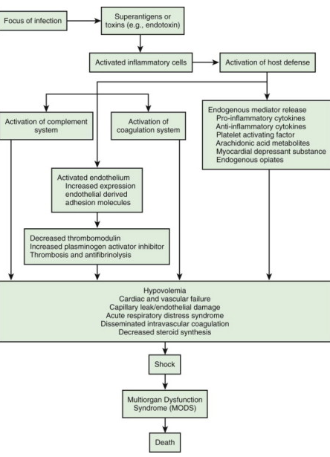

Slide 53
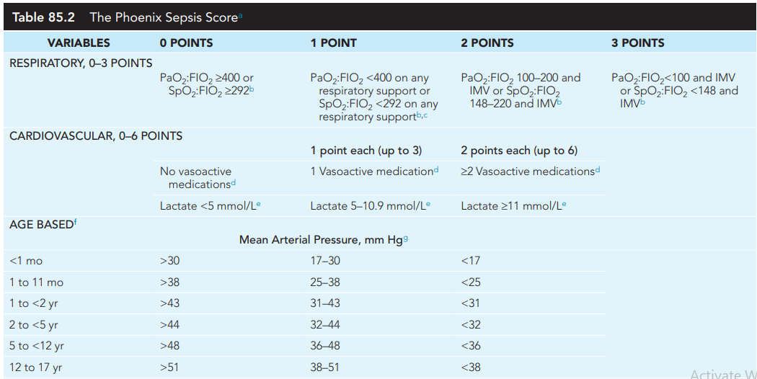

Slide 54
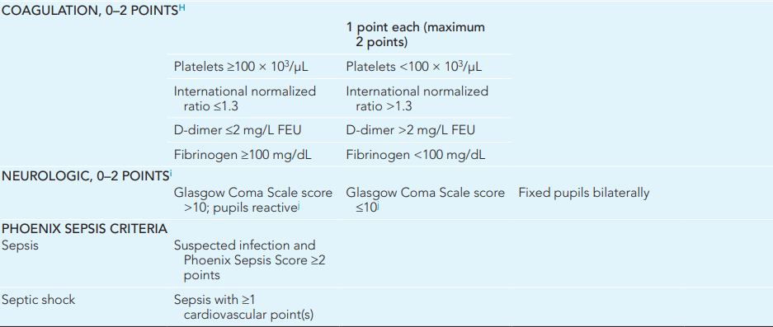

Slide 55
Clinical features
(Based on source of infection)
EARLY
Poor feeding +/- fever
A toxic or ill appearance
Tachycardia, tachypnea,
Normal capillary refill
A bulging or sunken
fontanelle
Edema
Mottled extremities,
LATE
Respiratory failure,
Cyanosis,
Decreased pulses,
Delayed capillary refill
Cool extremities,
Lethargy, and coma

Slide 56
Septic Shock Management
First-Hour Bundle (2026 Surviving Sepsis Campaign):
1. Obtain IV/IO Access
Two large-bore IVs or IO if access is not achieved within 2 attempts
2. Collect Blood Culture
Obtain before antibiotics if possible, but do not delay antibiotics
3. Administer Empiric Broad-Spectrum Antibiotics
Within 1 hour of shock recognition
Choice based on age, immune status, local susceptibility patterns, and source of infection

Slide 57
Con’d
Neonates (<28 days): Ampicillin + Ceftazidime (or Cefotaxime) + consider Acyclovir
Children >30 days: Ceftriaxone + Vancomycin
Immunocompromised: Cefepime + Vancomycin
Toxic shock: Add Clindamycin
Intra-abdominal source: Add Metronidazole
4. Measure Lactate
Baseline lactate helps guide therapy
5. Provide Volume Resuscitation
10-20 mL/kg boluses, reassess after each
6. Initiate Vasoactive Medication
If shock persists despite fluid therapy

Slide 58
Con’d
Clinical Presentations:
Cold Shock: Vasoconstricted, prolonged CRT, weak pulses → Epinephrine
Warm Shock: Vasodilated, bounding pulses, flash CRT → Norepinephrine

Slide 59
Shock in Malnutrition
Causes include:-
Hypovolemic
Septic
Cardiogenic

Slide 60
Cont’…
Consider Shock when the child is lethargic or unconscious and has cold hands plus either of the following:-
  Slow capillary refill (longer than 3 seconds), or
  Weak, fast or absent radial or femoral pulses

Slide 61
Cont’…
Four key steps to manage shock are;
  Give an oxygen
  Give 10% glucose
  Prevent hypothermia
  Give an Iv fluid and follow up

Slide 62
Septic shock
Diagnosis has been made by;
  A sign of hypovolemic shock and
  Failure to improve after the first hour of IV fluids for management of shock in dehydration

Slide 63
Poor Prognostic Features
Etiology:
Septic shock carries the highest morbidity and mortality
Underlying chronic illness
Patient Factors:
Infant age (highest risk group)
Pre-existing chronic illness (mortality 6-9% vs. 3% in healthy children)
Immunocompromised state
Severity:
Need for mechanical ventilation
Fluid-refractory shock
Catecholamine-resistant shock
Multiple organ dysfunction syndrome (MODS)
Need for ECMO

Slide 64
Con’d
Laboratory Markers:
Elevated procalcitonin levels (nonsurvivors have significantly higher levels)
Elevated lactate (persistent hyperlactatemia)
Progressive metabolic acidosis
Treatment Factors:
Delayed recognition and therapy
Delay in antibiotic administration >1 hour
Fluid overload >10%
Key Message: Shock and MODS remain one of the leading causes of nonaccidental death in infants and children.

Slide 65
Prognosis
In septic shock, mortality rates are as low as 3% in previously healthy children and 6–9% in children with chronic illness (compared with 25–30% in adults).
With early recognition and therapy, the mortality rate for pediatric shock continues to improve,

Slide 66
Con’d
But shock and MODS remain one of the leading causes of nonaccidental death in infants and children
The risk of death involves a complex interaction of factors, including the underlying etiology, presence of chronic illness, host immune response, and timing of recognition and therapy

Slide 67
Treatment Goals and Follow-up
Clinical Goals for Successful Resuscitation:
Hemodynamic:
Decreasing heart rate (first sign of reversal)
Blood pressure rising to age-appropriate range
Strong peripheral pulses
Warm extremities
Perfusion:
Capillary refill time <2 seconds
Improving mental status (less irritable, more alert)

Slide 68
Treatment Goals and Follow-up
Metabolic:
Urine output >1 mL/kg/hour
Falling blood lactate levels (≥10-20% decrease)
Correcting metabolic acidosis
Respiratory:
Decreasing respiratory rate
SpO₂ ≥94%
Follow-up and Escalation:
All shock patients require careful follow-up and monitoring:
Reassessment: Patients should be reassessed after each intervention

Slide 69
Treatment Goals and Follow-up
Transfer: All patients in shock should be referred to a higher-level facility after emergency care and stabilization
Monitor: Continue to monitor hemodynamic and metabolic parameters
Escalation: If no improvement, consider transfer to PICU or ECMO
Documentation:
Document response to treatment before and after each intervention
Monitor trends in vital signs and laboratory values

Slide 70
Summary
Shock is is life threatening conidtion if not timely detected and managed.
We have five general categories of shock
General treatement measures beginning from ABCD of life
Treating specific types of shock with ionotropes,antibiotics,blood transfusion in addition to volume expansion.

Slide 71
Con’d
In fluid-Refractory and Catecholamine-Resistant Shock cosideration of other atypical and revesible causes is needed and,
Second-line Vasoactive Medications, and Stress-dose Corticosteroids can be used for management

Slide 72
References
Kliegman RM, St Geme JW, Blum NJ, et al. Nelson Textbook of Pediatrics. 22nd ed. Elsevier; 2024. Chapter 88: Shock.
Weiss SL, Tissieres P, et al. Surviving Sepsis Campaign International Guidelines for the Management of Sepsis and Septic Shock in Children 2026. Pediatr Crit Care Med. 2026;27(4):379-434.
Bjorklund A, Resch J, Slusher T. Pediatric Shock Review. Pediatrics in Review. 2023;44(10):551-565.
Goldstein B, Giroir B, Randolph A. International pediatric sepsis consensus conference: Definitions for sepsis and organ dysfunction in pediatrics. Pediatr Crit Care Med. 2005;6(1):2-8.
WHO. National Standard Treatment Guidelines for the Primary Level. 2013.
Connecticut Children's Medical Center. Septic Shock Clinical Pathway and Medication Guide. 2025.

Slide 73
Thank you

